Slide 1
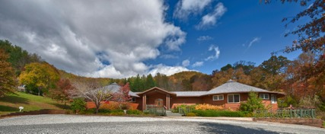
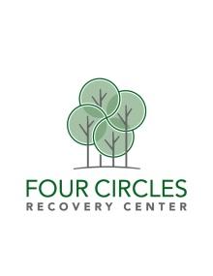
A look at…
Four Circles recovery center

Slide 2
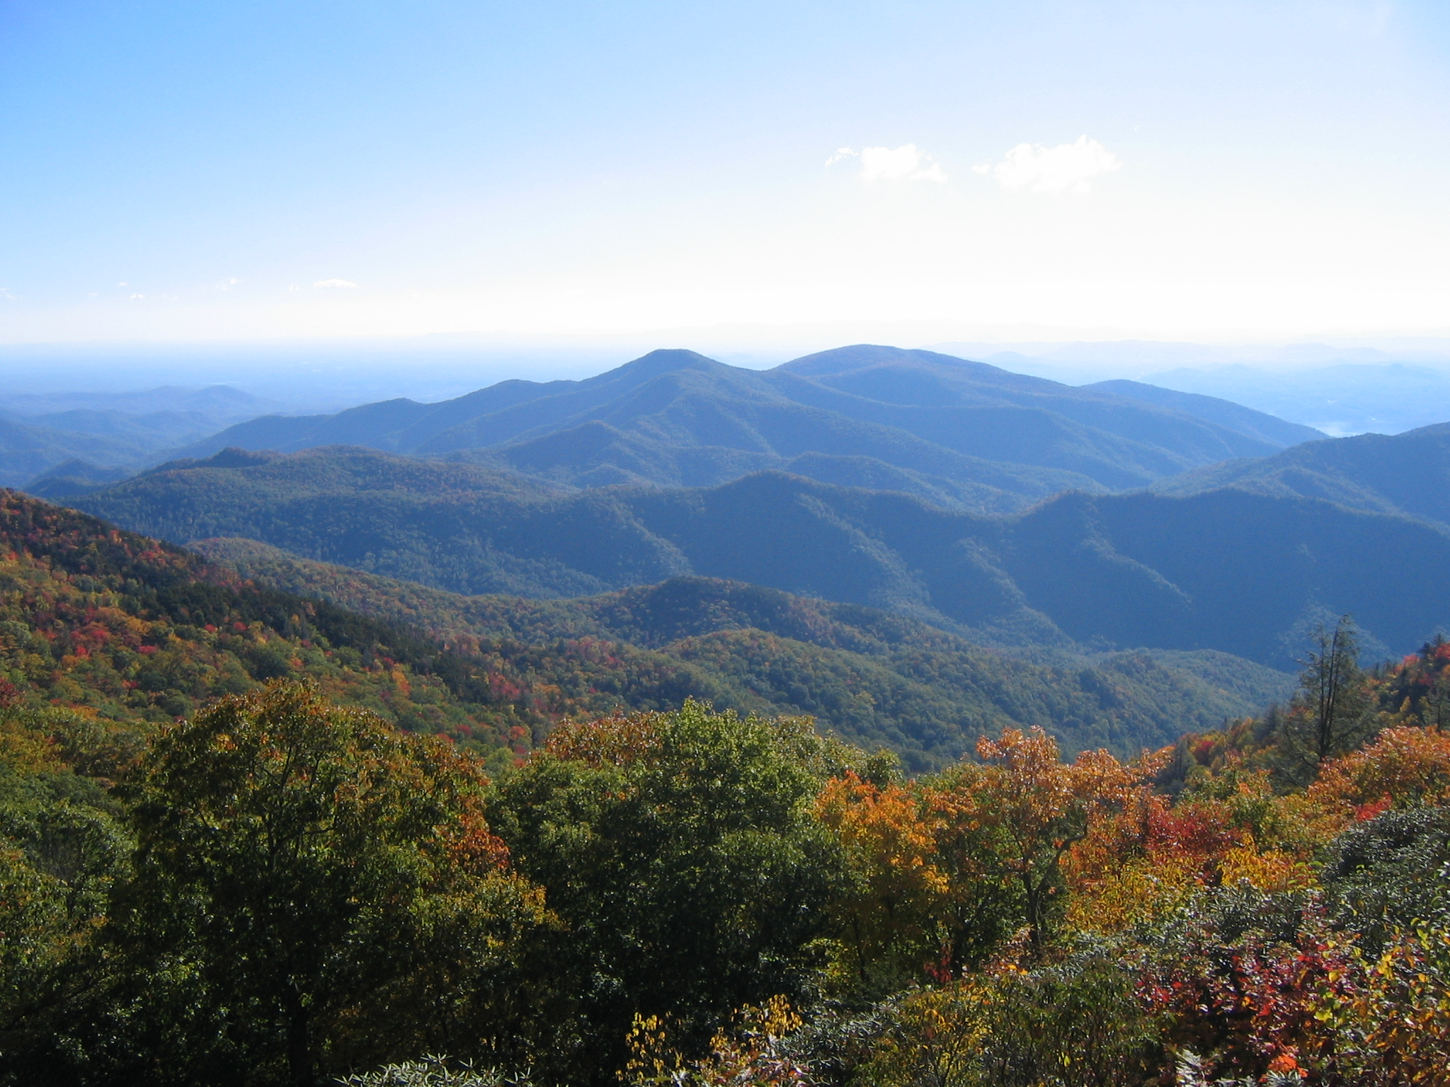
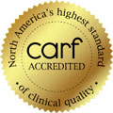
Licensed by the state of North Carolina
Four Circles Recovery Center is a state of the art, wilderness-based, licensed substance abuse treatment program for young adults ages 18-28. Four Circles is fully accredited by the Commission on Accreditation of Rehabilitation Facilities (CARF).

Slide 3
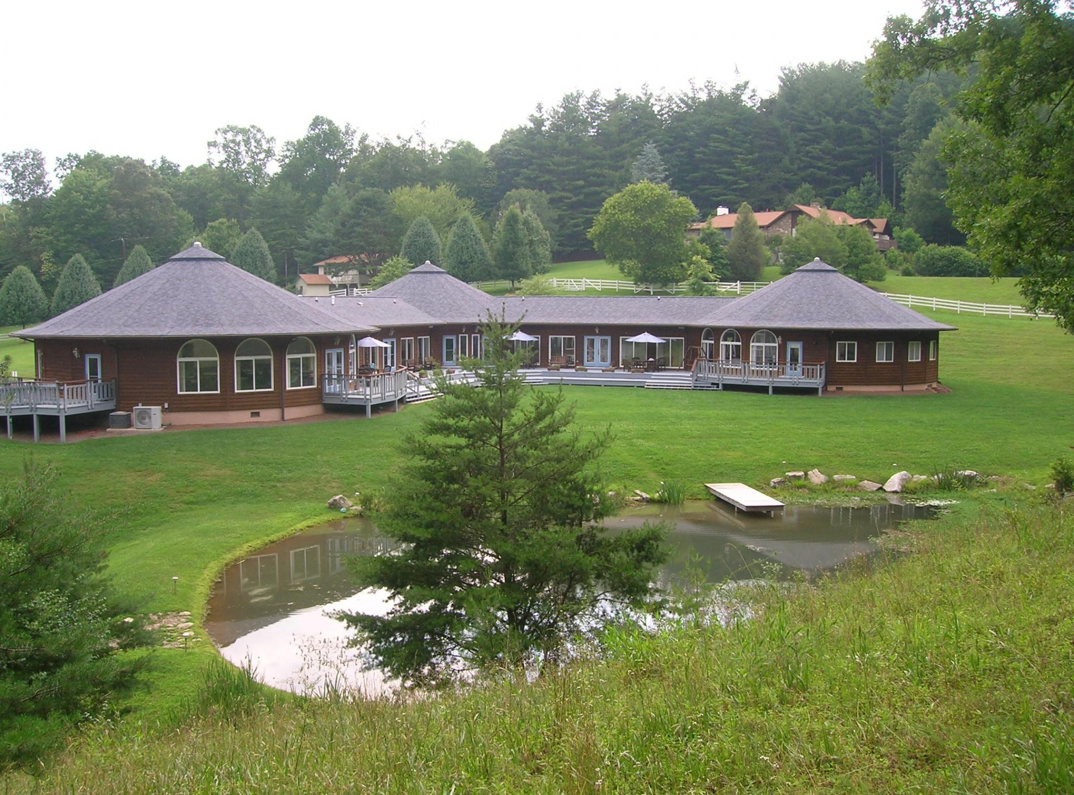

Slide 4
Gender-Specific Programs
Women’s Program at FCRC
Men’s Program at FCRC
Family Therapy work
Weekly calls with Primary Therapist
Gorski-CENAPS© Relapse Track
21-28 day minimum
Successful return to Recovery Path
Two-day Family Workshops
Family therapy calls each week

Slide 5
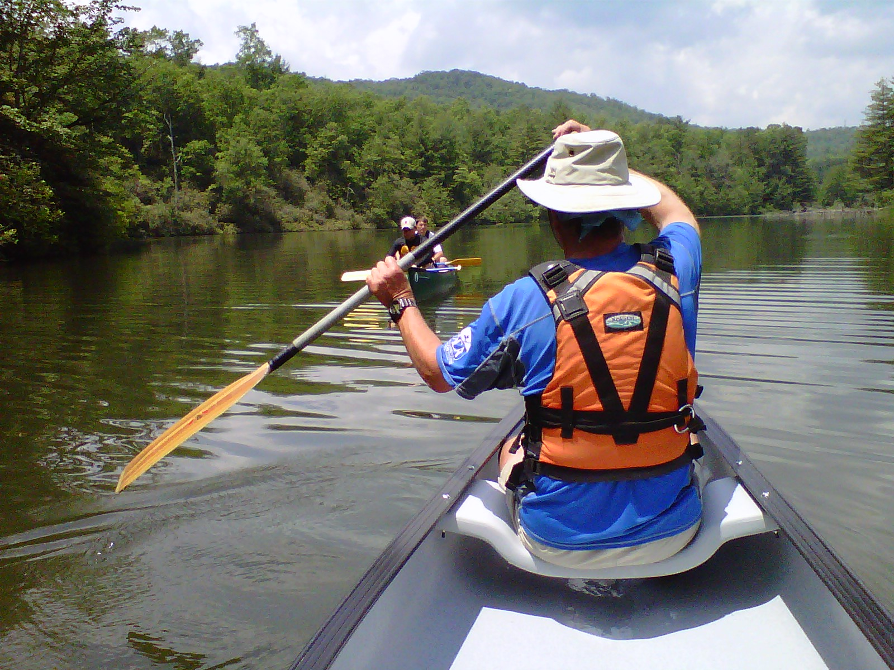
“Four Circles has given me my family back!”
- Rebecca R, parent

Slide 6
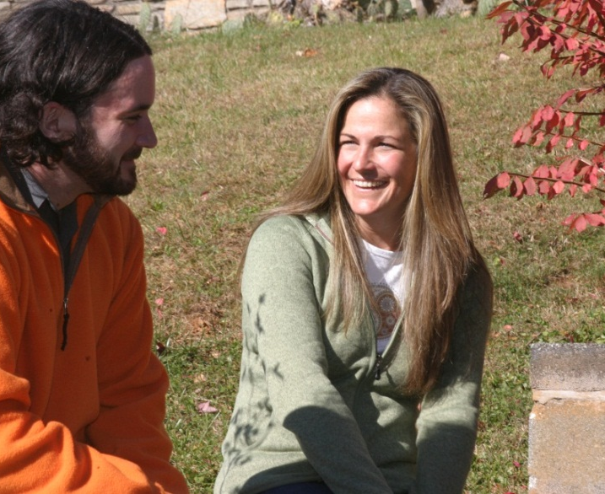
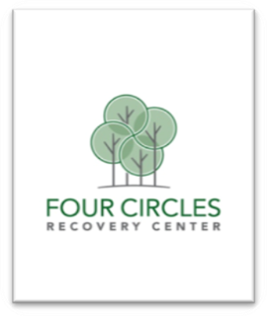
Clinical Team
At Four Circles

Slide 7
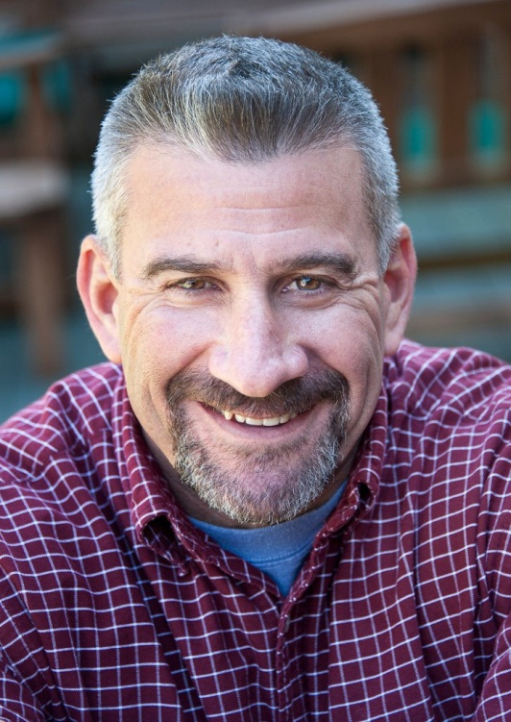
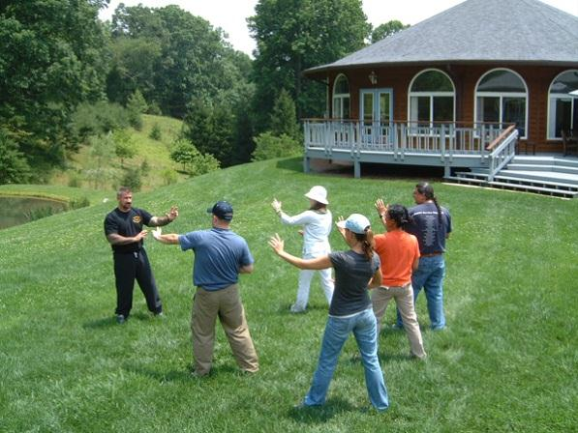
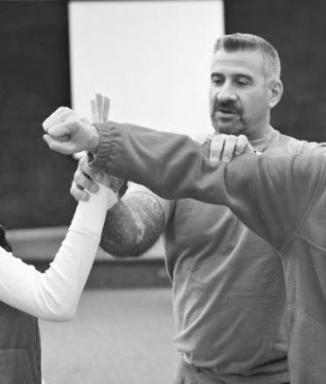
Jack Kline, MS, LPC, LCAS, CCS
Executive Director
Addiction/Recovery Issues
12 Step Facilitation
Marriage and Family Therapy
Adventure Based Counseling
Gender Identity Issues
Sexual Abuse
Reactive Attachment Disorder
Systemic Family Interventions
“I enjoy the challenge of blending the science of clinical theory, research, and analytical thinking with the art of delivering therapy. The results of helping others improve their level of functioning in the world is almost tangible and immediate. There is also a ripple effect – by helping one person help themselves, their families improve, their immediate communities improve and ultimately society benefits.”

Slide 8
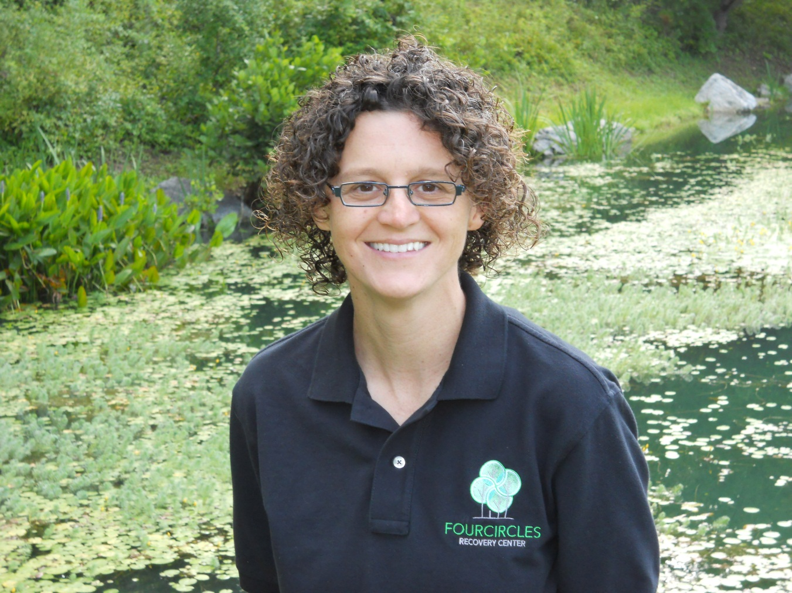
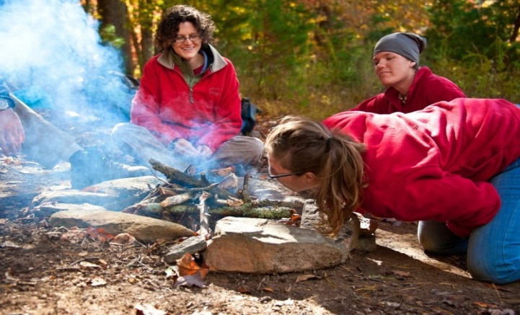
Heather Schnoebelen, MA,LPC,LCAS
Clinical Director
Anxiety Disorders
Gender Identity Issues
Wilderness Therapy
Oppositional Behavior
Personality Disorders
Family Systems
Gestalt Therapy
Depression
Self-Esteem Issues
Trauma
“I love this work because it allows me to combine my love for the magic and beauty of the natural world with my passion for the magic and beauty of the human spirit. I have devoted myself to this work because I am honored enough to work with and witness people aspiring to grow and change and I can not imagine a more perfect job.”

Slide 9
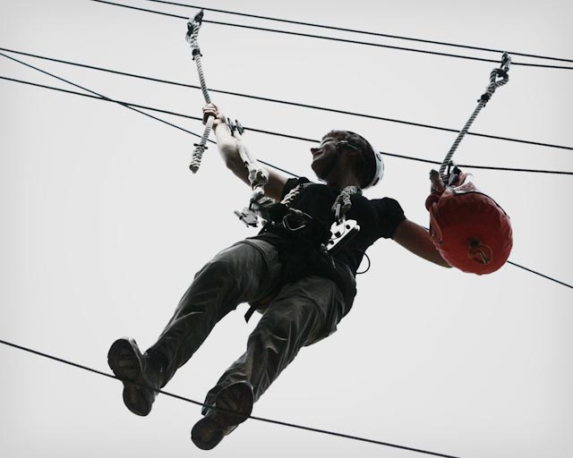
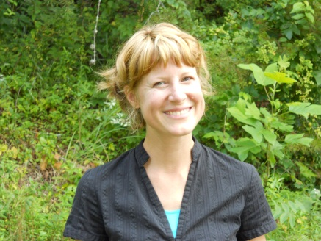
Melanie Weis, Ph.D, LPC, LCAS-P, NCC
Program Manager
Grief and Loss
Self-Esteem
Depression
Domestic Violence
Anxiety Disorders
Addictions
Self-Esteem
Gestalt Techniques
Trauma
DBT
“I am passionate about my work because I have witnessed the transformative power of therapeutic interventions. I feel privileged to meet with individuals as they confront themselves and begin the journey of becoming who they want to be.”

Slide 10
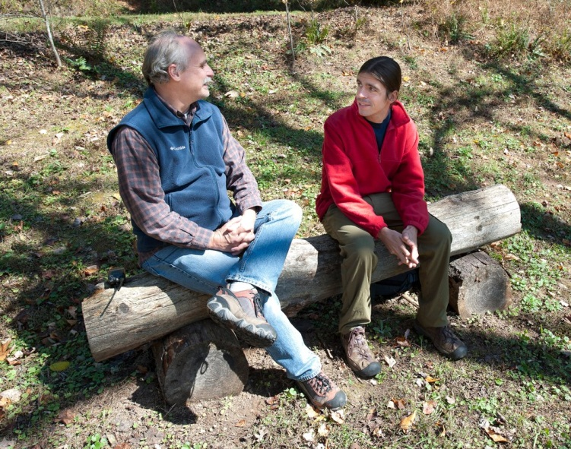
Tommy Lee, MA.ED, LCAS
Therapist
Motivational Interviewing
12-Step Facilitation
Conduct Disorder
Oppositional Defiance
Authority Issues
Family Systems
CBT
Dual Diagnosis
Gender Identity
Legal System Involvement
“I enjoy the energy of young people. I also love watching them learn that they are capable of more than they believe they are.”
“Four Circles is ‘what’s up’!” - Matthew M, Alumni

Slide 11
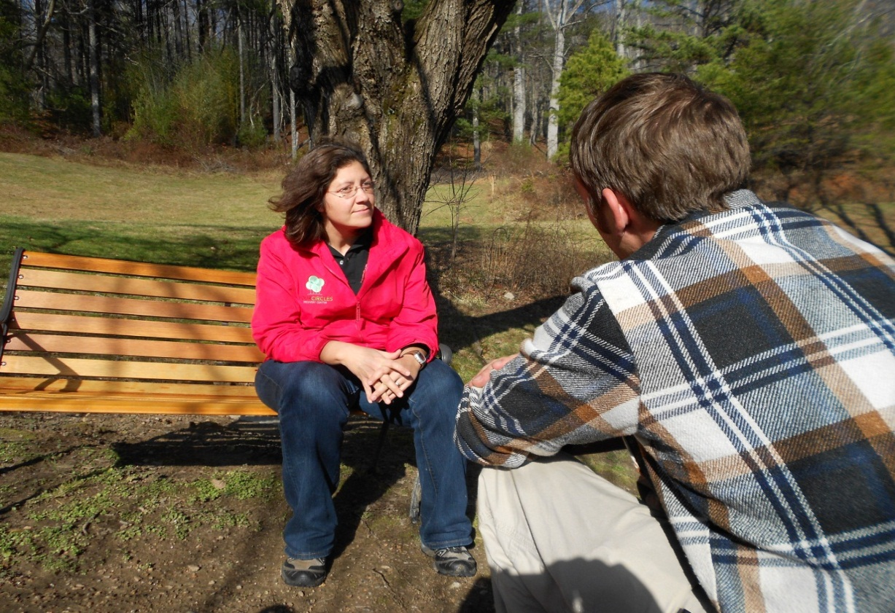
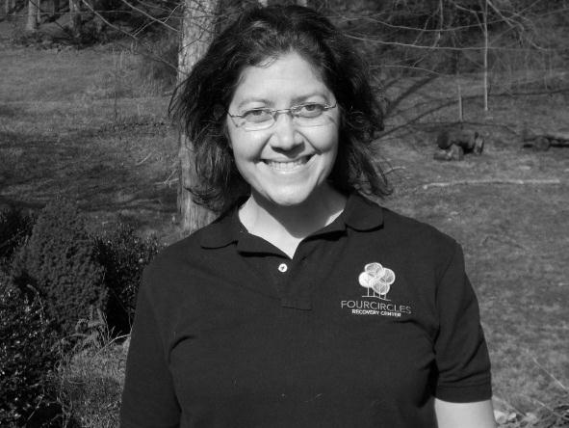
Rebekah White,Ph.D Clinical Psychologist
Therapist
Psychological Testing
Addiction
Dual Diagnosis
Trauma
Mood Instability
Anxiety
Eating Disorders
Crisis
Diversity and Oppression related issues
“I feel like the luckiest person in the world because I get to work at Four Circles with young men and women who come in and truly heal. The program forces clients to let go of the superficialities and distractions of daily life which allows them to work through the underlying core issues that get them here. It’s an incredible process to be a part of and a sincere honor.”
Rebekah quote

Slide 12
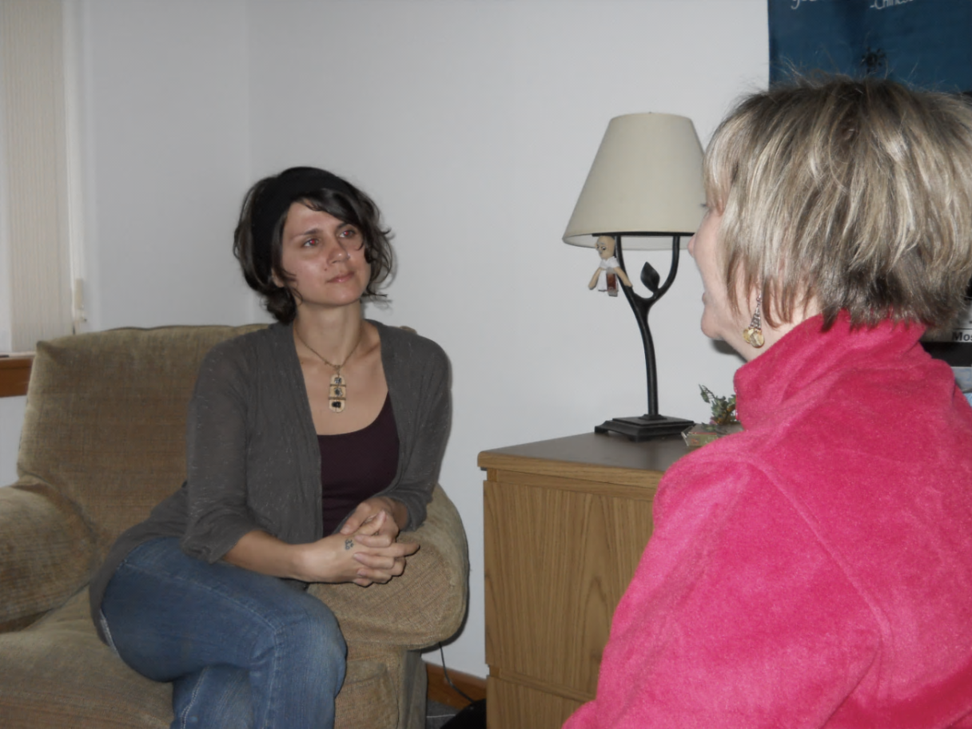
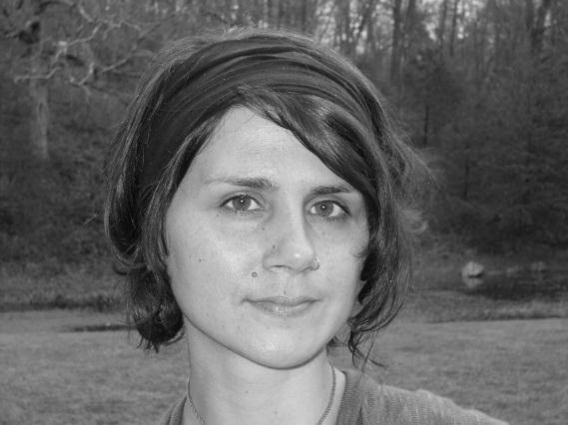
Carrie Schear, MSW, P-LCSW
Therapist
Dual Diagnosis
Depression
Anxiety
Women’s Issues
CBT
DBT
Learning Disabilities
Adult Children of Alcoholics Issues (ACOA)
Male and Female clients
“I truly the love the work I do and I look forward to being here each day. While the work may be at times challenging, it is equally rewarding to know that you are assisting and supporting young people, in reclaiming their lives and helping families to restore hope and healing.”

Slide 13
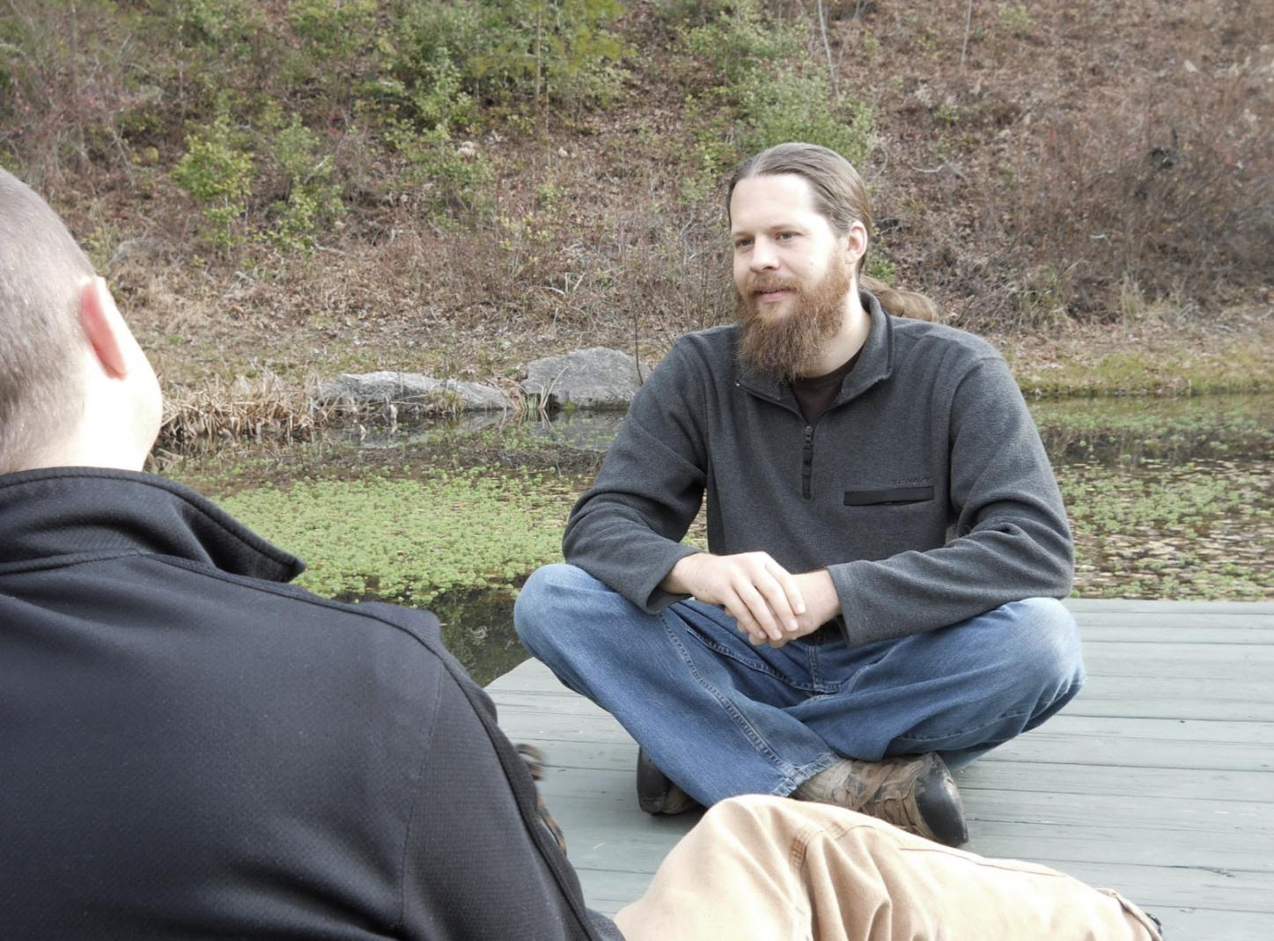
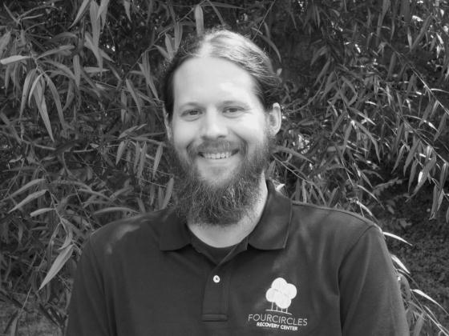
Bryan Dieterich, MA, LPC
Therapist
Addiction
Depression
Dual Diagnosis
Emotional Trauma
Grief
Stress and Anxiety
Gestalt Therapy
Rites of Passage
"This work has such tremendous appeal to me because I find the healing power of the natural world to be unparalleled. To help reconnect others to the land and through that experience to themselves for both personal healing and transformational growth is a profound honor."

Slide 14
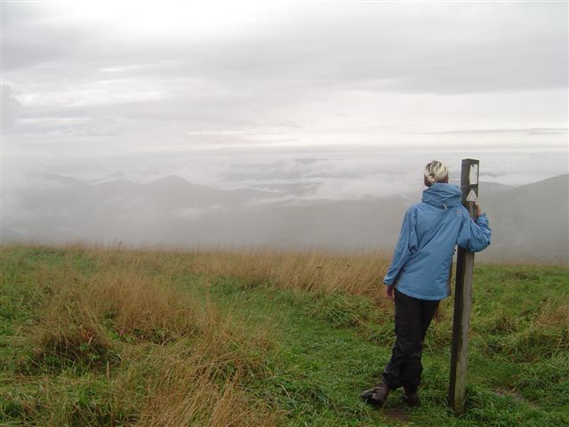
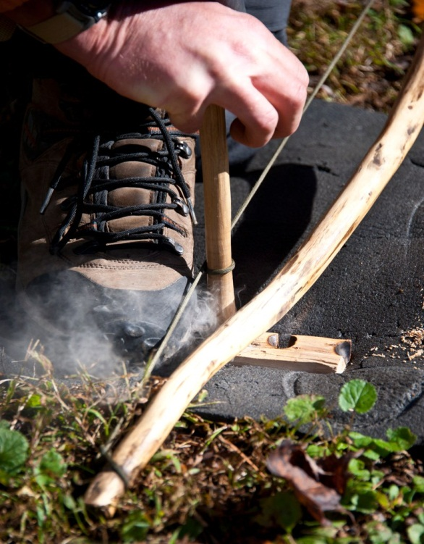
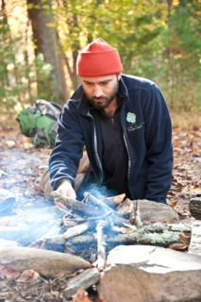
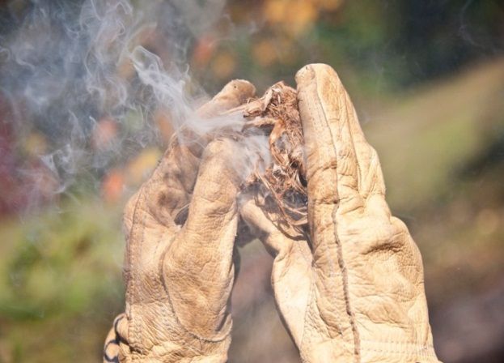
“Four Circles has changed my son’s life, and our family.”
- Lisa R, parent

Slide 15
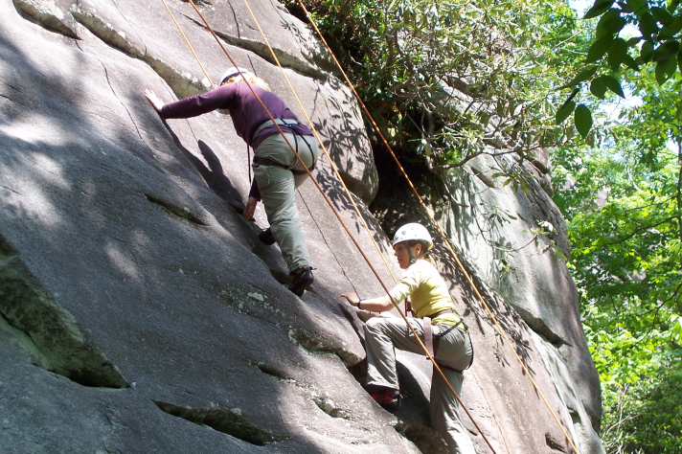
Excellence and effectiveness
At four circles

Slide 16
Program advantages
What sets Four Circles apart?
Open admissions, 7 days a week
Program Features
Four Circles Clinical Excellence
Bio-Psycho Social assessment for all new clients
Program Success
Both short and long-term effectiveness
88 percent of all admits complete treatment at Four Circles
Convenient to local medical and psychiatric appointments, if needed
42 day minimum stay with flexible length according to individual need
Comprehensive Psychological testing available on campus as optional service
Hybrid Residential/Wilderness model
Individualized, strength-based treatment plan
Entire Clinical team comprised of Master’s and Doctorate level therapists
97 percent of all graduates agree to continued care plan
95 percent family and professional satisfaction rate (Aspen programs survey)
Sustained Recovery Rate 2 - 3 times better than national average (University of Arkansas Study)

Slide 17
Psychological Testing
A comprehensive battery of psychological, educational, and career/vocational testing is available as an optional service. A thorough psychological evaluation provides relevant and important information about the client’s:
* Career and vocational testing is included
* Recommendations for maximizing recovery and success
* Current level of functioning
* Possible emerging psychopathology
* Any underlying learning difficulties
* Identification of risk factors
With four circles

Slide 18
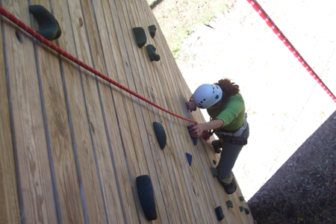
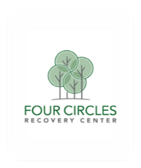
Family program
At Four circles

Slide 19
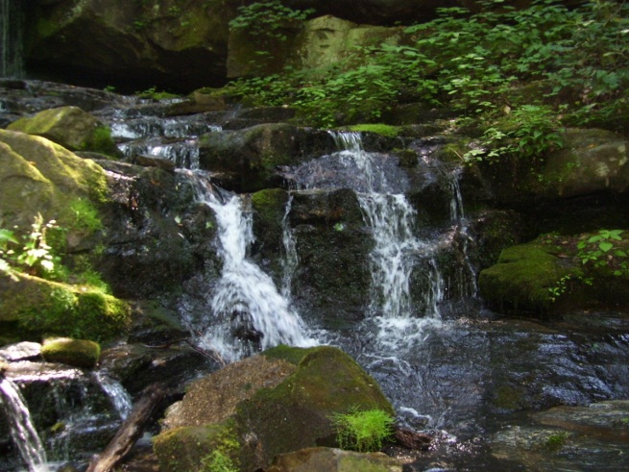
Weekly phone calls with Primary Therapist and weekly Family Support Calls
Suggested readings from a clinical perspective
Program designed Family Workbook
Intensive Family Systems Workshop with Multi-Family Adventure Therapy

Slide 20
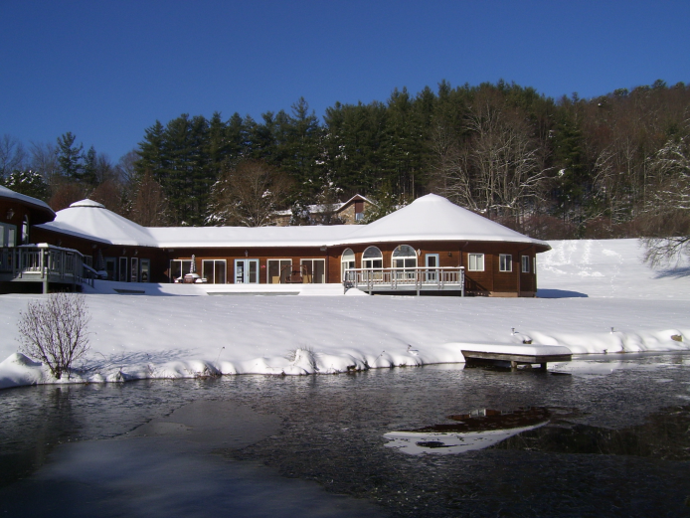
Gorski-Cenaps© Relapse program
At Four Circles

Slide 21
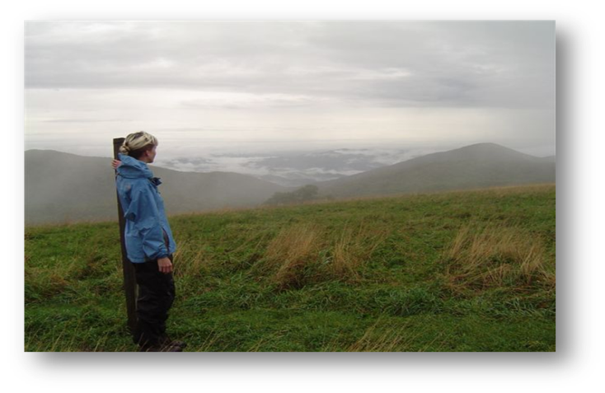
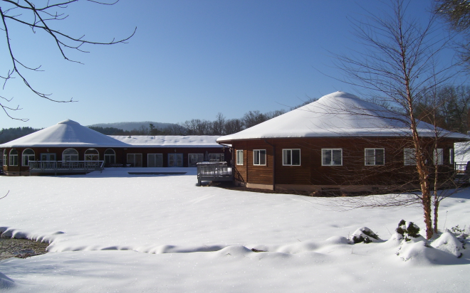
Therapeutic support to help clients successfully re-integrate into their recovery plan
Treatment setting incorporates both residential and wilderness programming
21 day minimum curriculum and structured aftercare planning with a Gorski-CENAPS© trained therapist
Special pricing for clients referred by transitional living programs

Slide 22
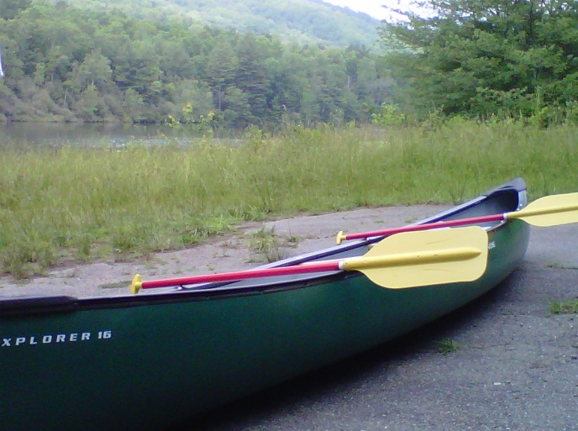
Program details
At four circles

Slide 23
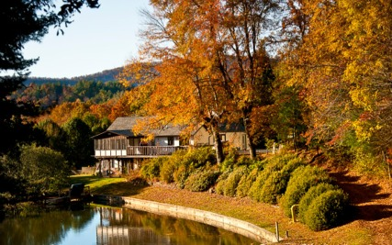
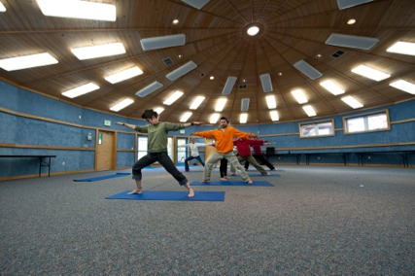
$485 per day/$2000 enrollment
CRC Loan services available
Daily cost breakdown available upon discharge
Detox services available at local hospital as needed
15 minutes from Asheville Regional Airport

Slide 24
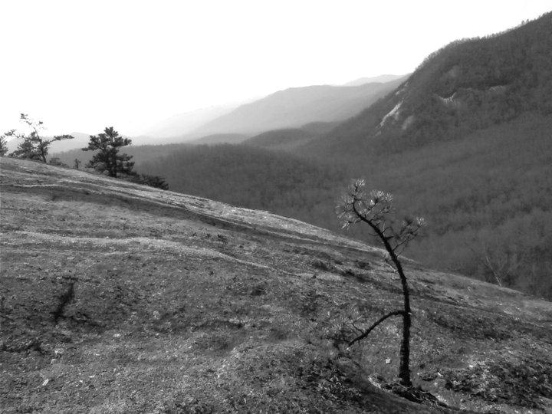
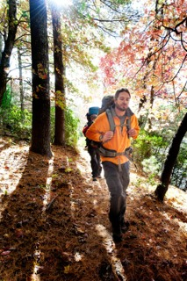
"Four Circles reconnected me with myself. Allowed me to realize what is important in life – let me find my true happiness."
Rick P - Alumni

Slide 25
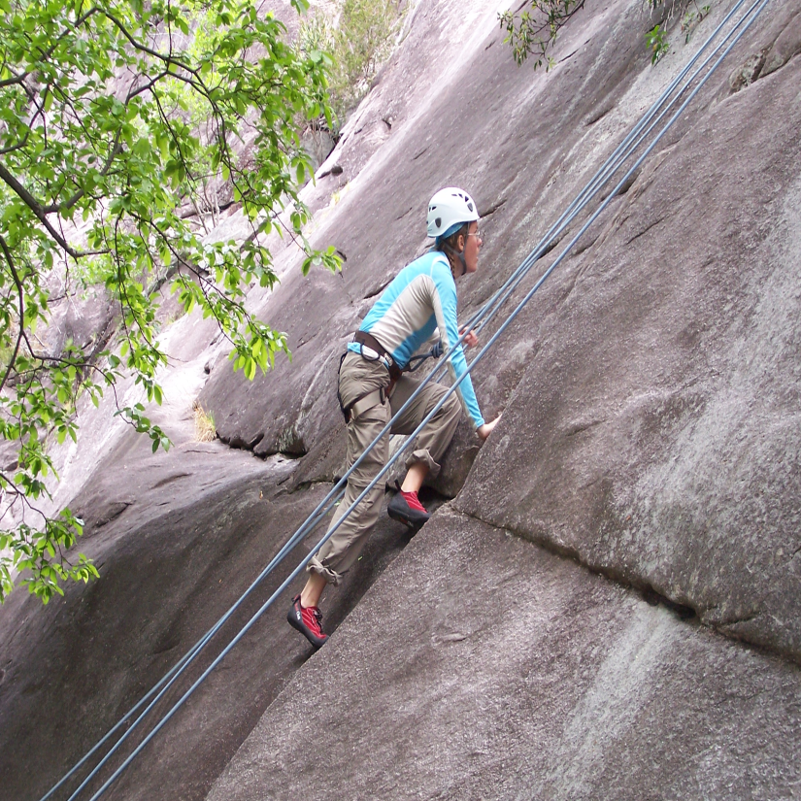
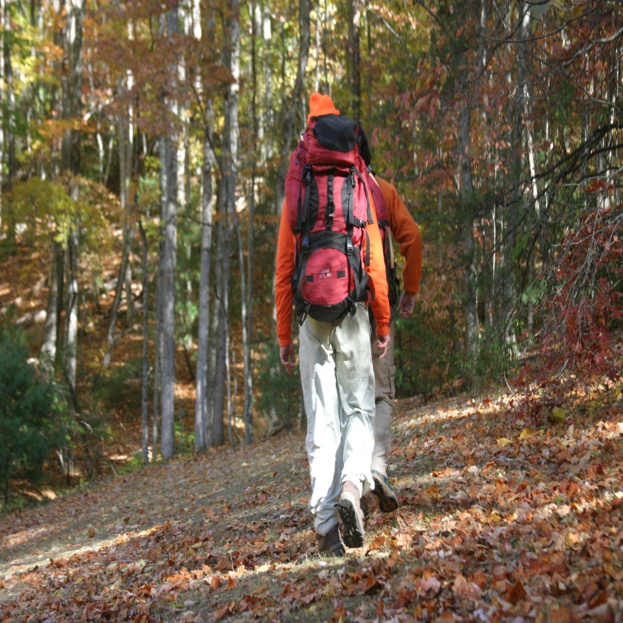
Mental
Physical
Emotional
Spiritual

